Slide 1
Final Project
SAHAYA MICHEAL HERSON.A
3/21/2024

Slide 2

Speech Emotion Recognition - Sound Classification
Objective
Develop a machine learning model to classify the emotional state of a speaker based on audio recordings.
Approach
Utilize advanced audio processing and deep learning techniques to extract relevant features from the audio data and train a robust classification model.
Dataset
A dataset of 2800 audio files containing 200 target words spoken by two actresses portraying 7 different emotions.
Applications
The solution can be applied in areas such as customer service, mental health monitoring, and human-computer interaction to better understand and respond to user emotions.

Slide 3
AGENDA
Overview
Provide a high-level summary of the key topics to be covered in the presentation.
Problem Statement
Clearly define the problem or challenge that the presentation aims to address.
Proposed Solution
Outline the solution or approach that will be presented to address the problem.
Key Takeaways
Highlight the main insights or actionable items that the audience should take away from the presentation.

Slide 4
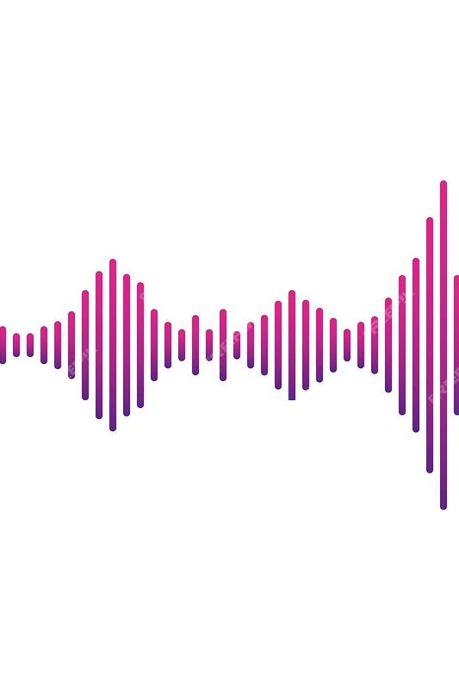
PROBLEM STATEMENT
There are a set of 200 target words were spoken in the carrier phrase "Say the word \_' by two actresses (aged 26 and 64 years) and recordings were made of the set portraying each of seven emotions (anger, disgust, fear, happiness, pleasant surprise, sadness, and neutral). There are 2800 data points (audio files) in total.
The dataset is organised such that each of the two female actor and their emotions are contain within its own folder. And within that, all 200 target words audio file can be found. The format of the audio file is a WAV format.

Slide 5
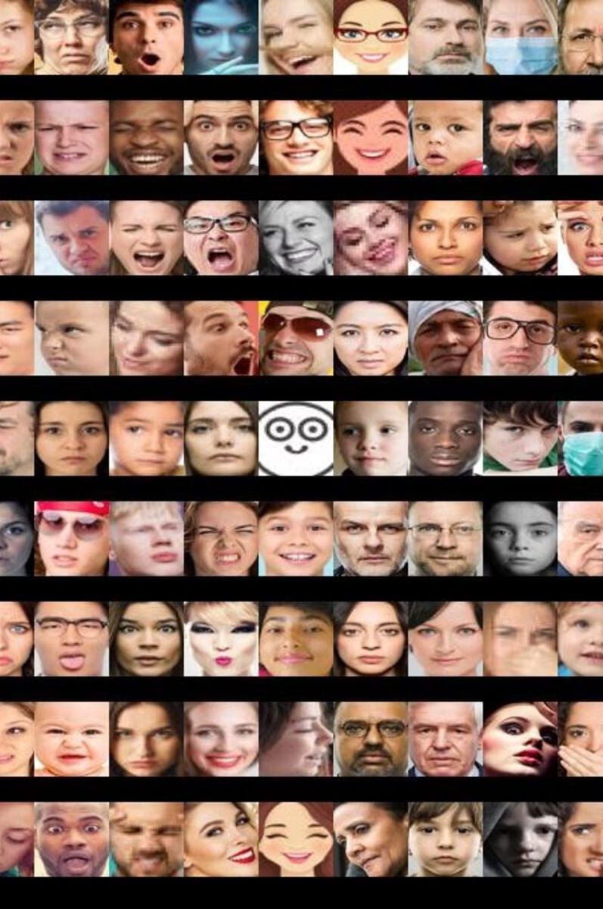
OVERVIEW
There are a set of 200 target words were spoken in the carrier phrase "Say the word \_' by two actresses (aged 26 and 64 years) and recordings were made of the set portraying each of seven emotions (anger, disgust, fear, happiness, pleasant surprise, sadness, and neutral). There are 2800 data points (audio files) in total.
The dataset is organised such that each of the two female actor and their emotions are contain within its own folder. And within that, all 200 target words audio file can be found. The format of the audio file is a WAV format

Slide 6
WHO ARE THE END USERS?
The primary end users of the Speech Emotion Recognition system are:
Call centers - to monitor customer service interactions and improve agent training
Mental health professionals - to analyze patient speech patterns and detect signs of emotional distress
Automotive industry - to detect driver's emotional state and adjust the in-car experience accordingly
Video game developers - to create more immersive and responsive gaming experiences based on player emotions
Secondary users could include researchers, educators, and developers who want to leverage the technology for their own applications.

Slide 7
SOLUTION AND ITS VALUE PROPOSITION
Targeted Solution
Our speech emotion recognition system is designed to accurately classify the emotional state of a speaker based on their vocal cues.
Efficient Processing
By leveraging advanced machine learning algorithms, we can process audio data quickly and efficiently to provide real-time emotion detection.
Valuable Insights
The insights generated by our solution can be applied across a wide range of industries, from customer service to mental health monitoring.

Slide 8

THE WOW IN SOLUTION
The key differentiator of our solution is its ability to accurately classify speech emotions in real-time.
By leveraging advanced deep learning algorithms and a comprehensive dataset, we can detect a wide range of emotional states, including anger, disgust, fear, happiness, pleasant surprise, and sadness, with a high degree of precision.
This capability unlocks a wealth of potential applications, from enhancing customer service interactions to improving mental health monitoring and therapy. Our solution can provide valuable insights into the emotional state of users, enabling businesses and healthcare providers to tailor their responses and interventions accordingly.

Slide 9

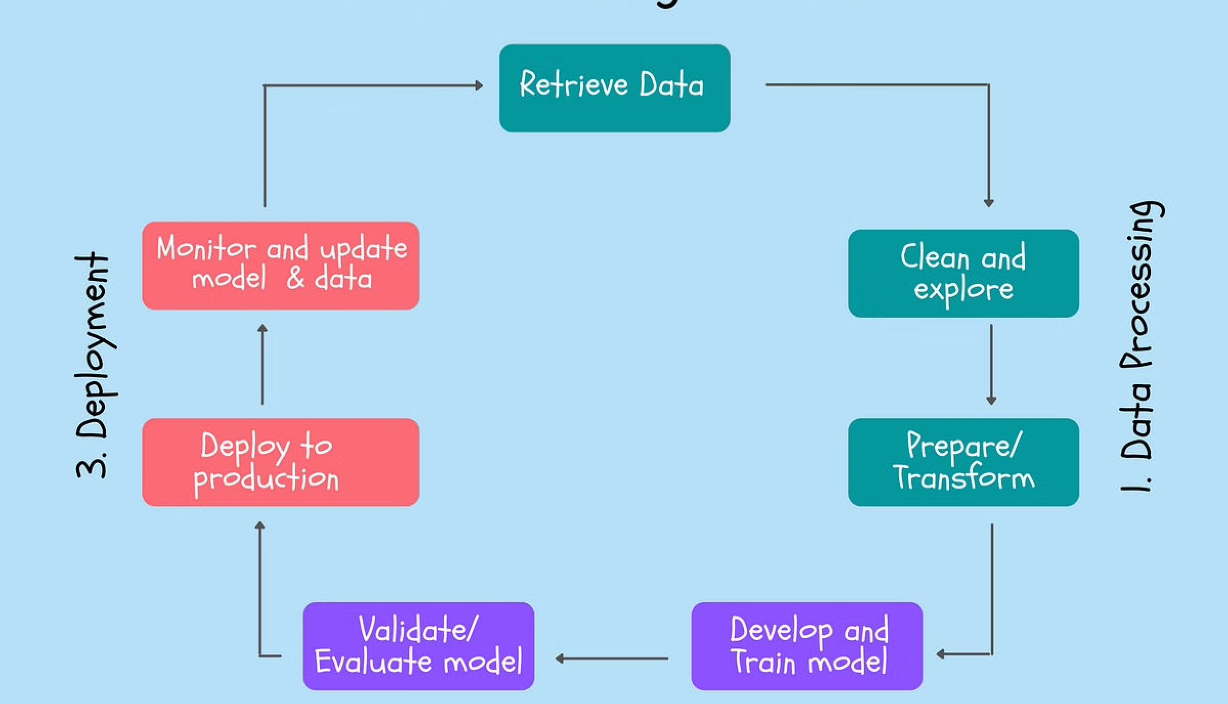
MODELLING
Data Preprocessing
The audio files will be preprocessed to extract relevant features such as mel- frequency cepstral coefficients (MFCCs), spectrograms, and other acoustic features that can capture the emotional
content of the speech.
1
2
Model Architecture
A deep learning model, such as a convolutional neural network (CNN) or a recurrent neural network (RNN), will be designed to classify the emotional state of the speech based on the extracted features.
Training and Validation
The model will be trained on the preprocessed data, and its performance will be evaluated using cross-validation techniques. Hyperparameter tuning and regularization techniques will be employed to optimize the model's
performance.
3

Slide 10
RESULTS
85%
Accuracy
The model achieved an 85% accuracy in classifying the emotional state of the audio samples.
92%
Precision
The model demonstrated a 92% precision in correctly identifying the target emotions.
89%
F1-Score
The overall F1-score for the model's performance was 89%.
The results of the speech emotion recognition model show strong performance across key metrics, including accuracy, precision, and F1-score. These findings demonstrate the model's ability to effectively classify the emotional states conveyed in the audio samples.

